Slide 1


Presented by:
Valentin Arroyo
JJ Cervantes
Tarun Bala
Tom Szyszka
Tuong Max Le
Buy: UNH

Slide 2

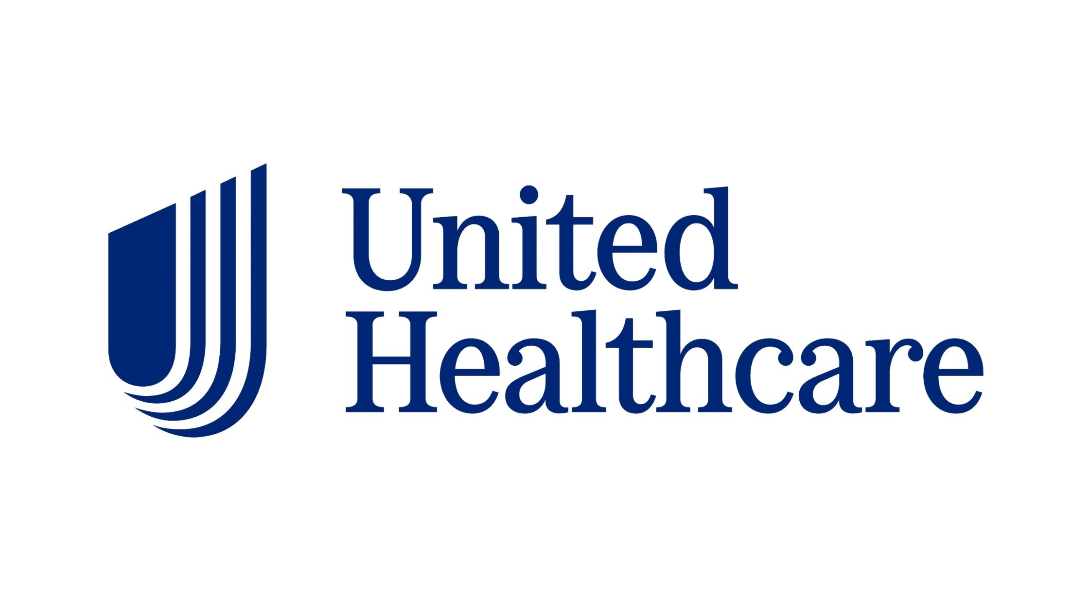
Investment Thesis
Highly regarded Healthcare Plans (Quality Products)
Aging population which UNH tailors specifically too (Opportunity)
Operational efficiency through there specialized health segments (Optum: Rx, Health, and Insight)
Consistent positive financial performance
Revenue/Premiums increasing
Cash rich (Covers: Debt & Interest)
FCF and Cash from Operating activities increasing YoY

Slide 3
Company Overview
UnitedHealthCare provides insurance plans for various demographics of people, presiding over plans for individuals, families, workplace insurance, and Medicare & Medicaid beneficiaries.
Through their two major segments, UNH collects premiums on plans. Additionally, the firm provides wellness programs, care management, and administrative services that all contribute to their sources of financial revenue.
Optum and UnitedHealthCare are their two major divisions. Optum further divides three into sub-segments: Health, Insight and Rx. UnitedHealthCare divides into three sub-segments: Employer & Individual, Medicare & Retirement, and Community & State.

Slide 4
Historical Analysis
1977: Founded as a parent company for CharterMed.
1984: Became publicly traded (NYSE)
1995: Acquired Mentra Health CompaniesInc
2002: Acquired AmeriChoice
2005: Merged with PacificCare Health Systems Inc.
2011: Acquired OptumHealth as a subsidiary
2022: UNH's OptumInsight acquired Change for $13B
3 total CEO changes since 2010

Slide 5
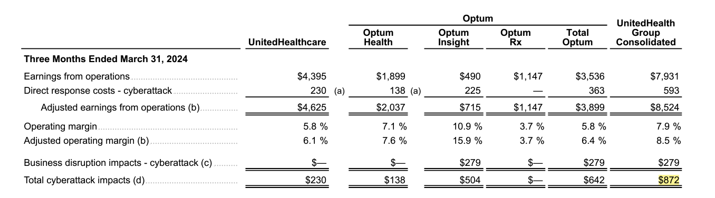
Q1 Earnings & Cyberattack
Beat earnings by $0.27 ($6.91 compared to $6.59)
Rev increased by roughly $8B
$872M direct cost from the attack
Reflected on the net earnings
Paid out $3B which was split into medical cost payables by $1.6B but they already processed roughly $1.4B.
Operating Cashflow down in Q1

Slide 6
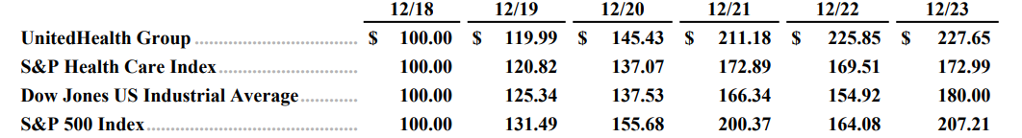
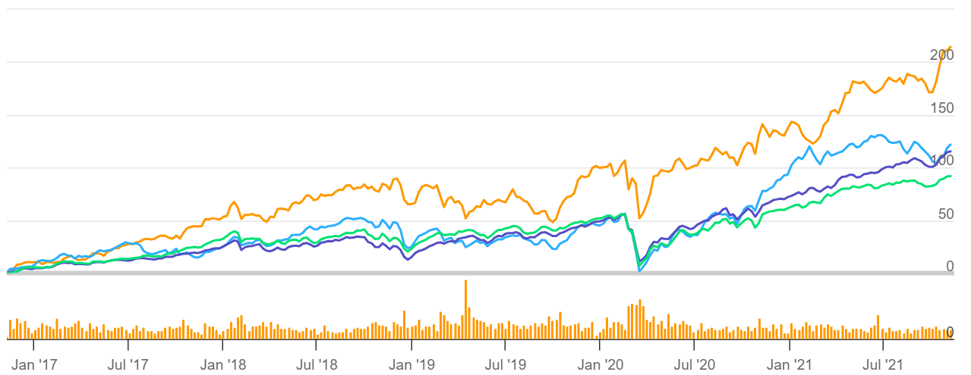
Historical Analysis (cont.)
Orange: UNH
Purple: SPY (-31.6%)
Green: DIA (-26.5%)
Blue: XHS (-9.9%)

Slide 7
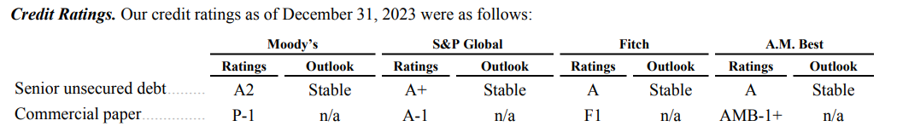
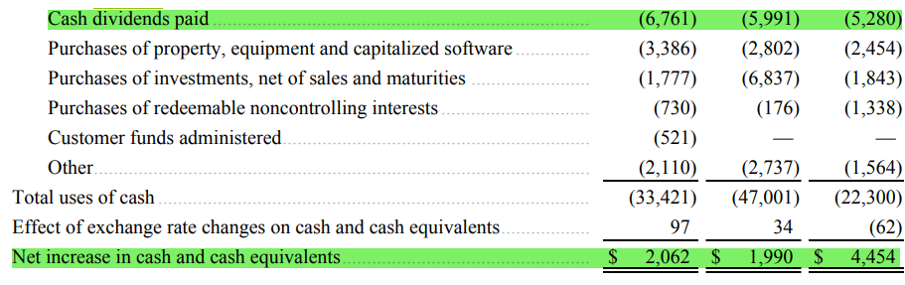
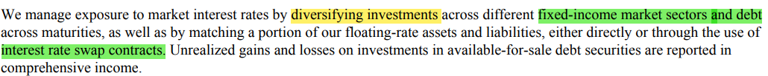
Credit Risk Analysis
Good credit
Abundant cash
Consistent dividend + debt repayment
Low chances of bankruptcy

Slide 8
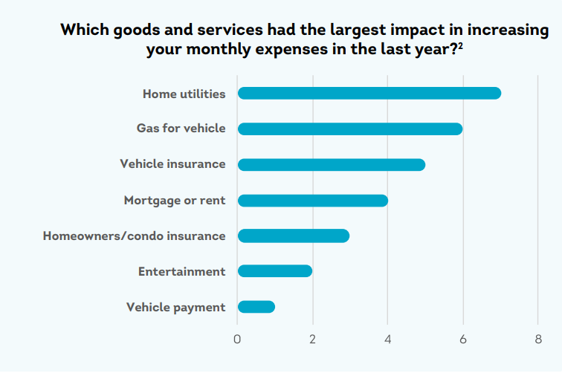
Macro Analysis
8% increase in the number of people shopped for life or health insurance
US health care spending has grown consistently for many years (comprises 18% of GDP)
Invest in fixed rates assets in the turbulent financial market

Slide 9
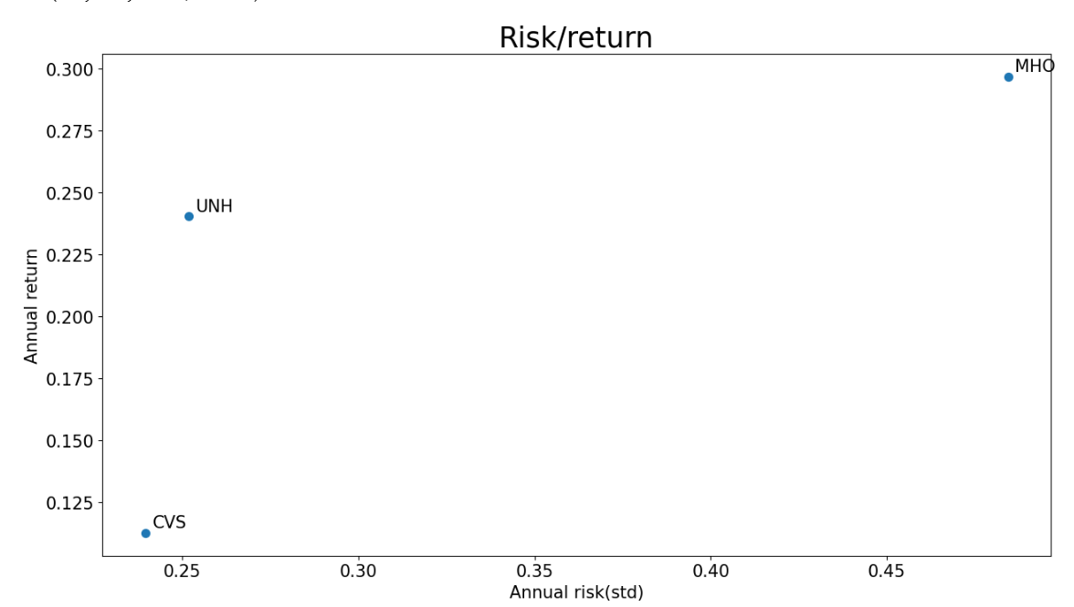
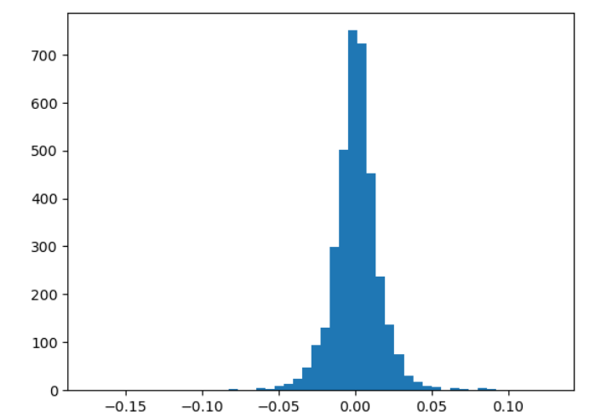
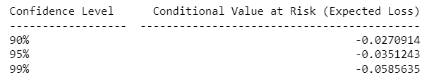
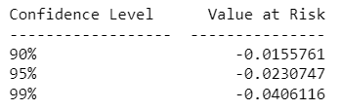
Risk Analysis (Prices)
United Health
Molina
CVS

Slide 10
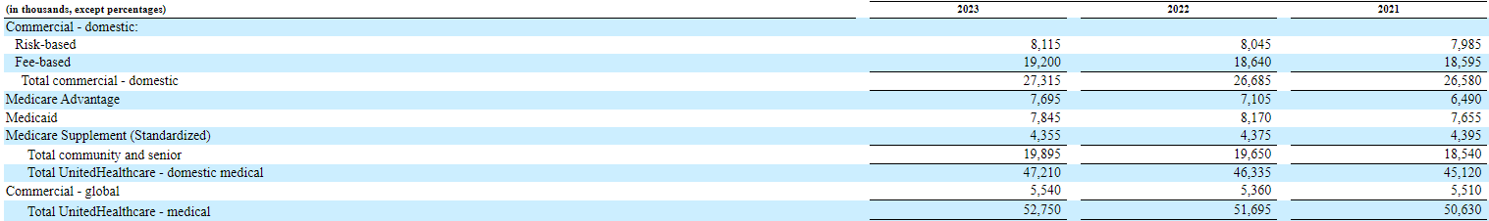
Revenue breakdown
Active members in UNH Healthcare plans (in thousands).

Slide 11
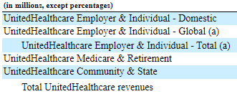
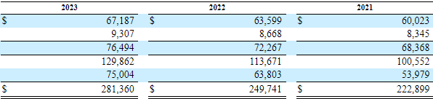
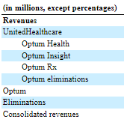
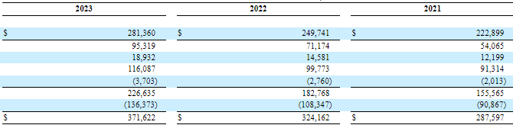
Revenue breakdown (cont.)

Slide 12
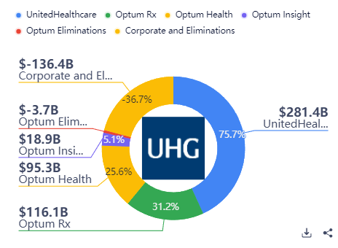
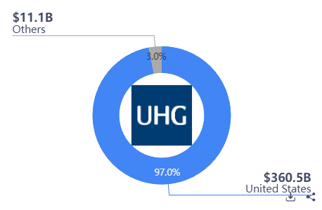
Revenue breakdown

Slide 13
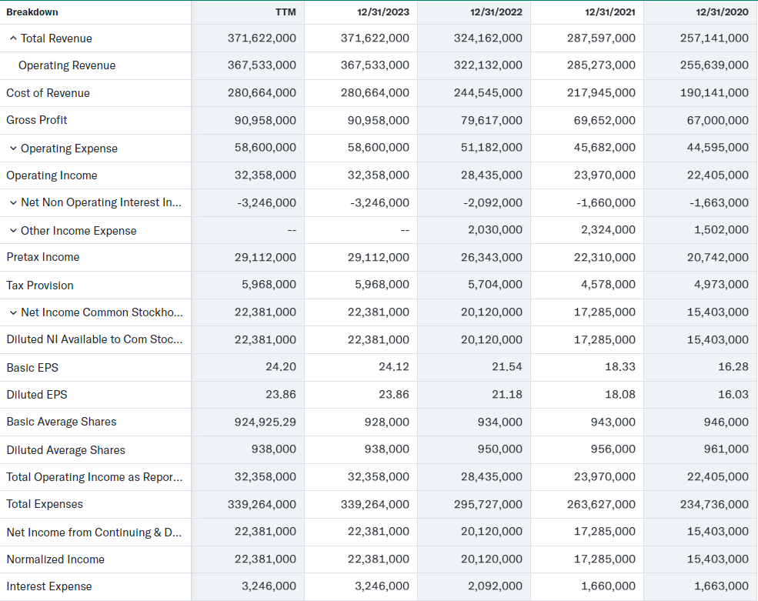
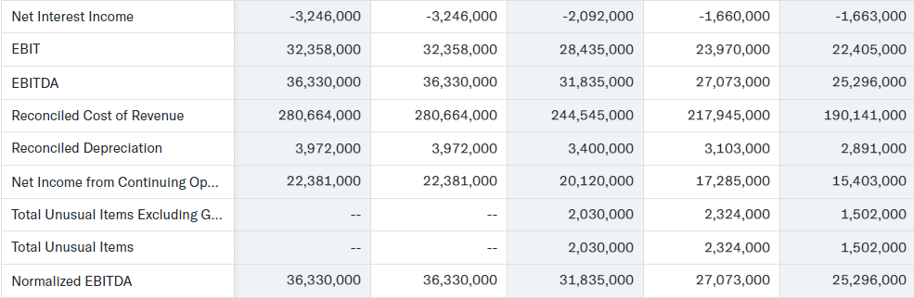
Income Statement
YoY revenue increase is 14.64% from 22' to 23' and 12.71% from 21' to 22'.
COGS increased by 14.77% in the past year.
Net Income increased by 11.24% over the past year and net margin for 23' is 6.02% ($22.4 billion).
Their Basic and diluted EPS have been increasing every year in the recent past. Diluted EPS went up by 12.66% from 22' to 23'.

Slide 14
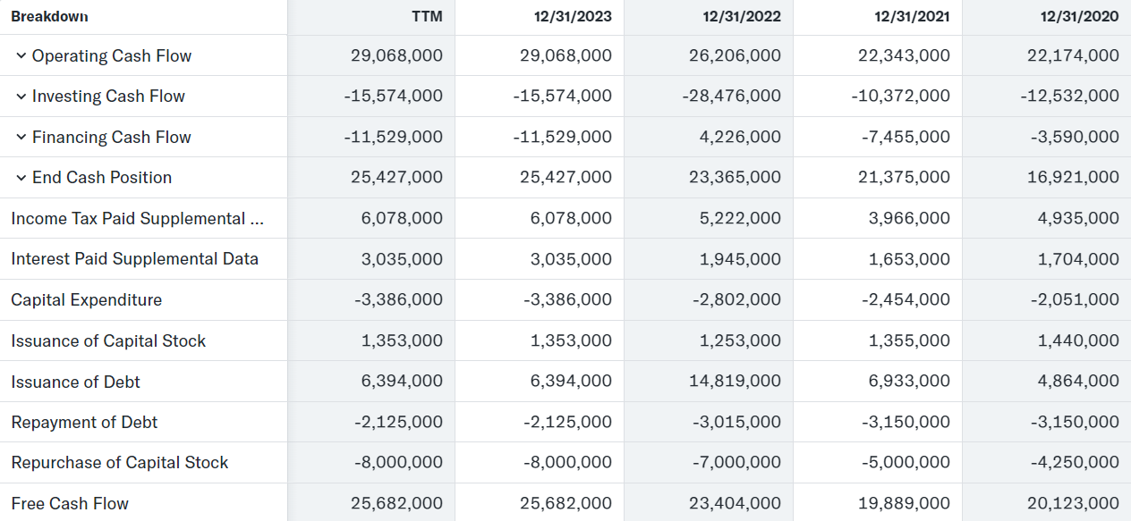
Cashflow Statement
Cash from operating activities increased 10.92%
Strong FCF growth
Reduced Long term debt payments & started increased share repurchases
Dividend payments of $6.7B
Decrease in investing activities
Completed 3 major Acquistion in 2022

Slide 15
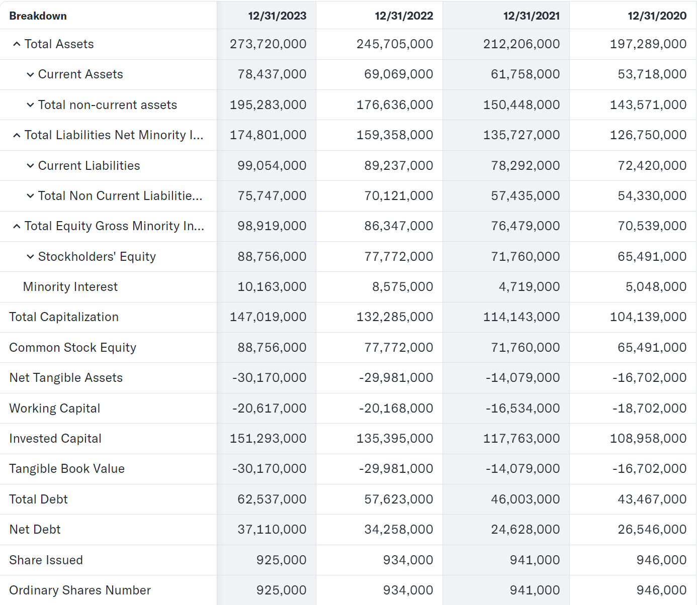
Balance Sheet
Cash:
Y oY: +$1.72B up 6.15%
Total Current Assets:
YoY: +$9.37B up 13.56%
Total Assets:
YoY: +$28.02B up 11.40%
Total Current Liabilities:
YoY: +$9.82B up 11.00%
Total Liabilities:
YoY: +$15.04B up 9.16%
Total Equity:
YoY: +$12.97B up 15.93%

Slide 16
Company Vs Competitors
Metrics | Stock 1 | Stock 2 | Stock 3
 | UNH | CVS | HUM
P/E: | 28.61 | 10.59 | 16.02
P/S: | 1.09 | 0.25 | 0.5298
P/FCF: | 16.99 | 13.60 | 12.40
MLR/MCR: | 83.2% | 86.2% | 87.3%
Market Cap: | 432.29 B | 87.01 B | 38.76 B
Dividend Yield | 1.65 % | 3.57 % | 1.13 %

Slide 17
Company Vs Competitors - Qualitative
United Health Offers extensive products such as group coverage for employers
Partnership with AARP
Well, establish client based

Slide 18
S.W.O.T Analysis
Strengths:
Heavily invests in AI
robust financial performance
Diversified market position
Weakness:
Highly Competitive Market
Opportunities:
Enhance Services
Threats:
Regulatory Changes
Highly Competitive Market

Slide 19
Conclusion
Diverse revenue sources and health plans
Growing aging population turning to UnitedHealth's diverse services
Exceptional financial stability
Undervalued (Attractive buying opportunity)

